Slide 1
Case study - superstore sample
Mateusz Lutomski

Slide 2
Scenario
You are a junior data analyst working for a business intelligence consultant. You have been at your job for six months, and your boss feels you are ready for more responsibility. He has asked you to lead a project for a brand new client — this will involve everything from defining the business task all the way through presenting your data-driven recommendations. You will choose the topic, ask the right questions, identify a fresh dataset and ensure its integrity, conduct analysis, create compelling data visualizations, and prepare a presentation.
The mentioned brand new client, is a large retail company, called SooperCoolStore (fictional name, we'll call them SCS), represented by Mr. Wingchun, who's the CFO's assistant. The SCS company wants to expand their business even further, but before that, they want to analyze their weak points, the areas where they could improve, and only then will they feel ready to build more facilities, broaden their product range, etc. That said, they need your help to identify where the areas for improvement are. It was not specified if you should look for improvable areas in any particular area of retail, SCS is open to any recommendations, as long as they're insightful and possible to incorporate.
To make the task achievable, they've provided you with dataset containing information about sales in years 2014-2017. The data is categorized into these variables - Order ID, Order Date, Ship Date, Ship Mode, Customer ID, Customer Name, Segment, Country, City, State, Postal Code, Region, Product ID, Category, Sub-Category, Product Name, Sales Quantity, Discount and Profit. Dataset contains almost 10000 rows of data.

Slide 3
Business task and stakeholders
The business task is to find the areas for improvement in SCS' performance.
Inner stakeholder would be a coordinator of the project, VP of Analytics in my company, Mrs. Leebruce.
The key stakeholder will be Mr. Wingchun, and perhaps the people he decides to take with him (that may include more decisive personnel from SCS company). However, it was not specified whether someone's going to join him, so for now he's the only stakeholder.

Slide 4
Dataset information
Dataset I'm going to be using here is an open-source dataset which can be found here (Superstore Sales). The data is categorized into 17 variables - Order ID, Order Date, Ship Date, Ship Mode, Customer ID, Customer Name, Segment, Country, City, State, Postal Code, Region, Product ID, Category, Sub-Category, Product Name, Sales Quantity, Discount and Profit. Dataset contains 10291 rows of data. It consist of 1 .csv file, within which are two sheets - one called "Orders", which holds the majority of the data, the second one's called "Returns", and consists of only 2 columns called "Returned", which is a boolean type of data (every record says "Yes" and corresponding Order ID.
Since data was collected by the store itself, it's credibility shouldn't be questioned. It was collected first-hand, so I believe there's nothing to worry about.
When it comes to data integrity, I haven't encountered any biases in the dataset, it doesn't contain information which could be somehow misunderstood and gathered incorrectly. Sold merchandise is categorized, products have their unique names and ID's and the numbers regarding the sales (eg. quantity, price, discounts) don't seem to be invalid. Basically the dataset seems quite clean already, further cleaning processes will be covered in next chapter.
Personal information about buyers could be troubling. There are names, surnames, cities where each customer lives, which could be a setback, if we were dealing with an actual, real-world data. But since data is fictional, the problem does not exist.

Slide 5
Data processing and cleaning
Tool choice:
I've decided to use Google Sheets to perform an analysis, Google Slides to create a report and Tableau to create some visualizations. Because the dataset isn't really large, R/SQL will not be needed, Sheets can process that much data rather easily.
Data cleaning process:
- Blocked the first row, where the variables names were located, to not mess the whole spreadsheet with filters.
- Verified each column and dataset as a whole through filtering and sorting, mostly to get rid of invalid/empty entries
- Changed "United States" entries, to "USA" entries. Change is completely cosmetic, but I found it's easier to look at.
- Trimmed extra spaces
- Looked to remove duplicate rows (there were none)
- Added a column “Order Year”, which is an extraction of a year from “Order Date” column (used for filters in visualizations)
- Applied "$" data type to sales and profit variables, and "%" to discount variable.
- Inserted new column called "Returned" in the "Orders" sheet. It transfers the information from "Returns" sheet, which I was able to do with a VLOOKUP function:
=VLOOKUP(B2;Returns!$A$2:$B$297;2;FALSE) where:
B2 - Orders Order ID
Chosen range was the whole Returns sheet ($ are used to lock the range)
2 as to write "Yes", when order was returned
And FALSE, as I needed exact value match
Then I used conditional formatting to highlight the returned orders in a
red color.
- Created new column called "Company cost", by subtracting profit from sales
- Conditionally formatted the profit column, to highlight cells in red, where the values are negative.

Slide 6
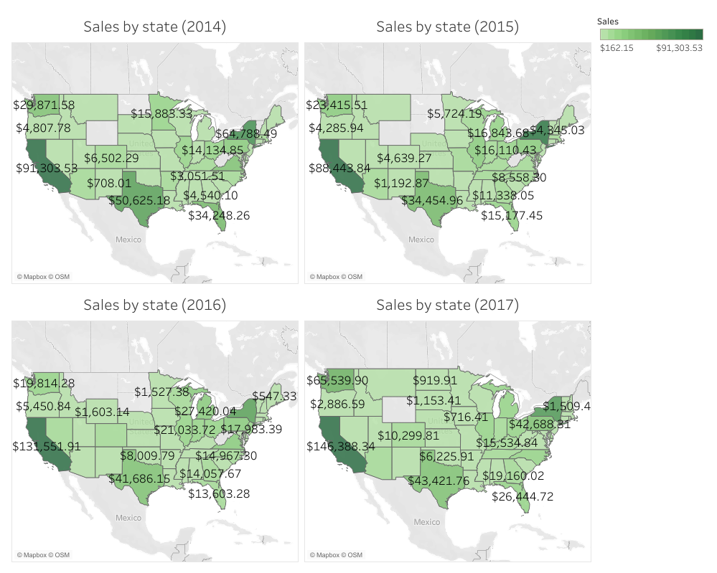
USA sales scope
Here we can see the scope of sales in every state in years 2014-2017.
Non-green areas did not have any sales in that particular year.
North-Central part of the country seems to be “unoccupied” - I would recommend looking into putting these states as target group for next advertising campaigns.

Slide 7
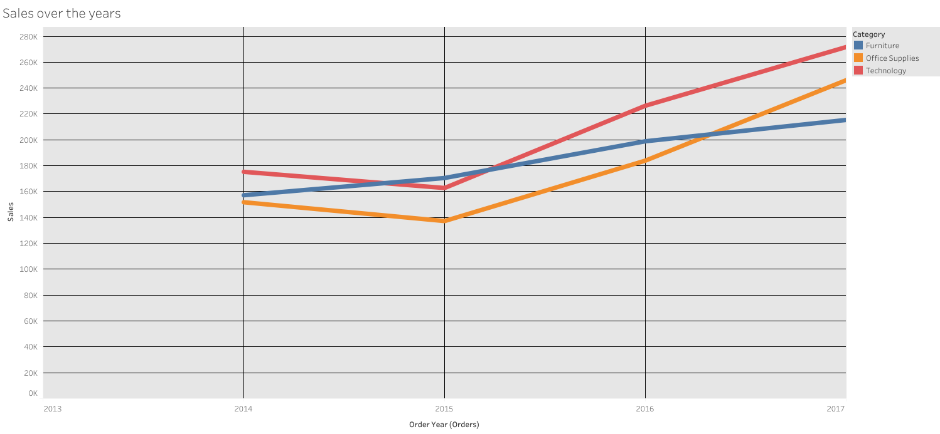
Sales progress
This chart presents the progress of sales through the 2014-2017 period.
As we can see, apart from small dip in 2015 (besides furniture), numbers are continuously going up!

Slide 8
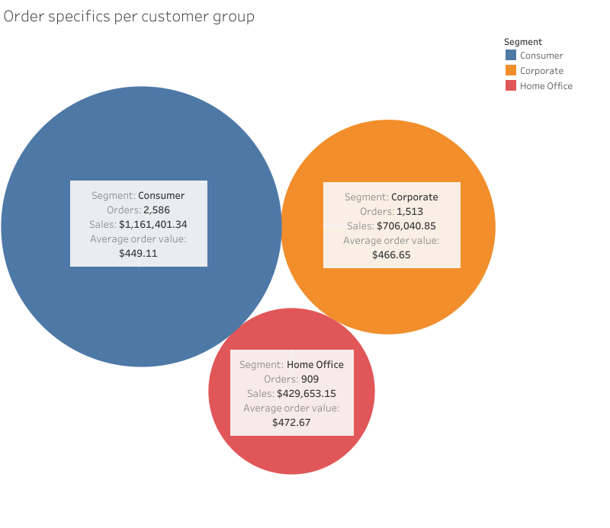
Orders in a nutshell
This little chart presents condensed info about customer groups. Even though they’re segregated differently, the average order values are close to each other.
Every group makes a large part of your income, so to encourage them even more, you could launch special limited time offers fit specifically for specific groups. Finding the preferences of each group would require further research.
It would also be a good idea to think about expanding the Home Office customer base.

Slide 9
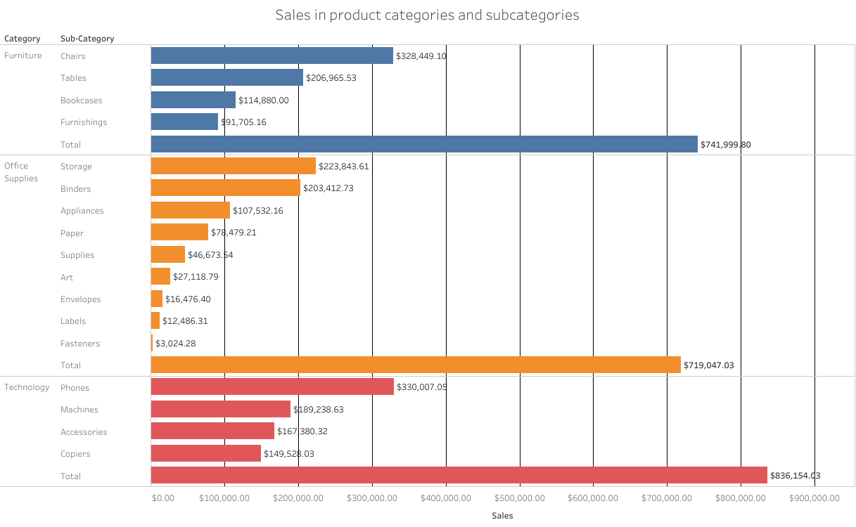
Overall sales
Technology is the best-selling sub-category. It’s not surprising at all, considering the times we live in. Although, sales don’t have to be equal to profits.
That said, I would like you to see the profits ->

Slide 10
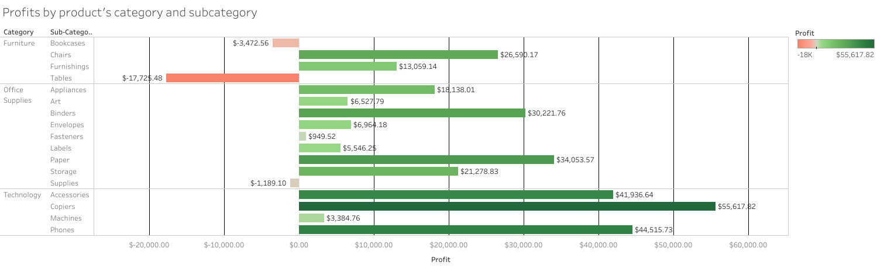
Profits by product’ category and subcategory
Interestingly so, copiers brought the least amount of money out of technology category products, but they are the most profitable ones.
Even though tables sales are have reached over $200000, it seems like your company is losing money over them. The exact difference stands at 8,56%. Let’s see, why that may be happening.

Slide 11
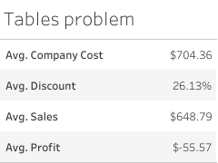
What’s wrong with tables?
The graph shows the problem with tables sales. Their average discount stands for a bit more than ¼ of its price (with max discount value being 50%). Knowing that SCS is at 8,56% average loss on every table, my suggestions are:
Reduce discounts initially to 20%, further in time the discount value may reduce even more.
Lift up the normal price.
See if there is any chance for bringing new models to sale, that might interest consumers, and therefore increase profits.
There is also an option to put some money which was meant to buy tables, to invest in some other more profitable item’ sub-category (e. g. Phones).

Slide 12
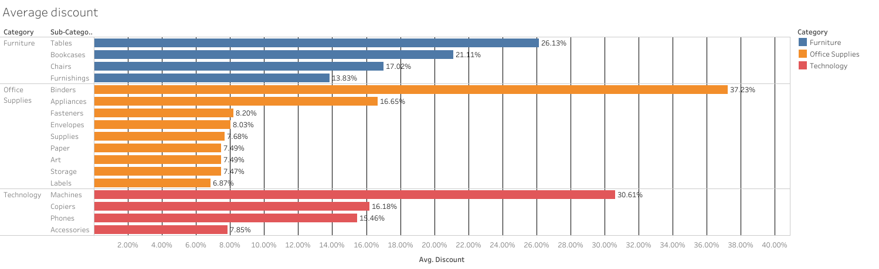
Discounts
Here are the averaged discount per product category and subcategory. I want to point out especially the discount values for Bookcases and Machines. Bookcases might use a little reduction of discount value, so they may be more profitable in the future. Machines are in a low profit territory, and offered average discount of 30,61% is rather high.

Slide 13
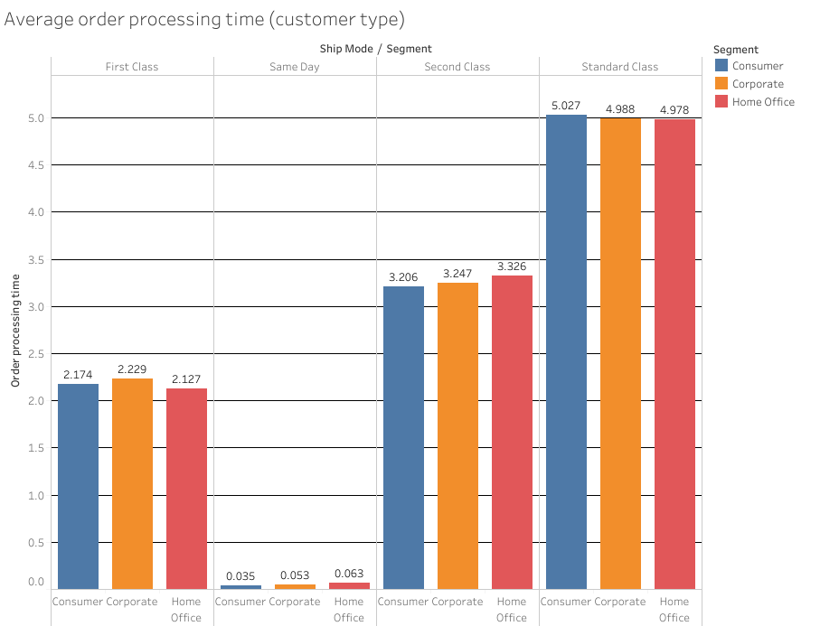
Order processing
Order processing time is the difference between order day and shipping day.
Here are the average order processing times differentiated by shipping mode and customer segment.
Customer segment shows no significant differences, which proves that there is no favouring some of the customers, which is certainly good customer-experience-wise.
If I also had an access to exact time of ordering and shipping, I would be able to see, why some “Same Day” orders were not shipped the same day. It could be human error as well as system’s fault, unfortunately I can’t be sure of it.

Slide 14
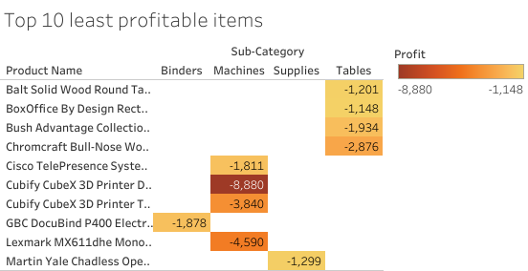
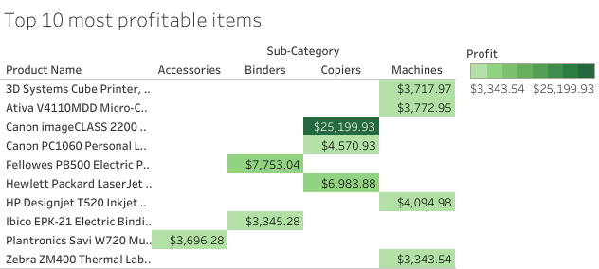
Most and least profitable items
8 out of 10 least profitable items come from sub-categories mentioned before - Machines and Tables. That’s another sign that shows something should be done about this, especially Machines. Individual losses might not seem that big, but accumulating these losses can take it’s toll in the future.
This chart shows, that some machines bring some true value to the company. Given more information about these products could allow me to see why some machines are much more profitable than the others. Data like customer ratings or complaints amount could be quite useful here.

Slide 15
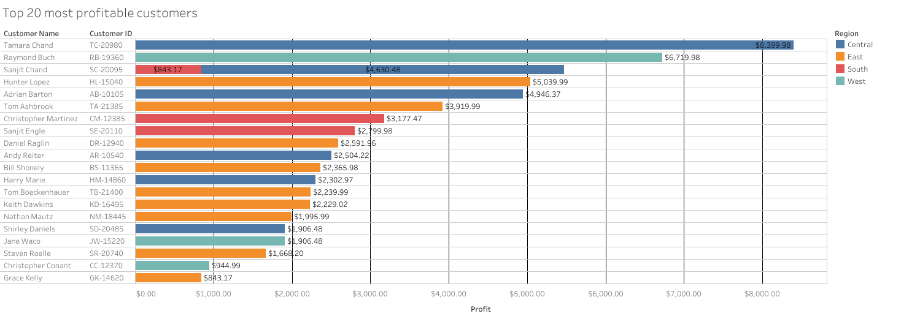
Top 20 customers
Looking into profits generated by customers gave me an idea of introducing the special loyalty programme for your most active customers. 20 is just a random number, it could be larger/smaller, but I believe that may reinforce your bond with most valuable customers.

Slide 16
Summary
Suggestions:
Remaking table selling strategy
Launching advertising campaign of Your store targeted at North and Central regions of the USA
Introducing a loyalty programme and limited time offers
Expanding customer base (especially Home Office segment)
Looking into changing some discount values
Increasing copiers’ share in Technology sales (due to huge profit opportunities)
Investing in Technology sub-category products
What should remain and prosper:
Stability in yearly revenue increase
Sales in East, South and West regions of USA (especially California and Texas)
Order processing times
Technology’ product sales

Slide 17
Thanks for Your time :)

